Slide 1

Heart Disease Prediction using Machine Learning
Madhurima Mukhopadhyay
Sarika Thumbapura Arun
Sinchana Datta Pushpa Datta
Shilpa Varadaraju

Slide 2

Introduction
Dataset: Heart Disease Dataset by David Lapp (Kaggle) with features like age, cholesterol, and blood pressure.
Goal: Apply logistic regression to predict the likelihood of heart disease.
Purpose: It helps identify major risk
factors and provides insights for early
detection and prevention.

Slide 3
Background
Heart disease is a major global health issue influenced by factors like age, cholesterol, and blood pressure.
Machine learning helps analyze complex datasets to identify individuals at risk.
Logistic regression is used for its simplicity and efficiency in predicting heart disease.

Slide 4

Cleaning and Visualization
Dataset has 1025 data rows, 13 features + target variable.
• Overall Idea: Data Summary, Datatypes of features
• Data Cleaning: Checked for Null Values, Removed duplicate rows
Cleaned dataset has 302 data rows, 13 features + target variable.
• Visualization: Created bar graphs, pie charts, and correlation heatmaps.
Key Findings:
- Cholesterol increases with age.
- Max heart rate decreases with age.
- Heart disease more prevalent in younger age groups.
- 68% male patients in the data, 45.7% have heart disease.

Slide 5
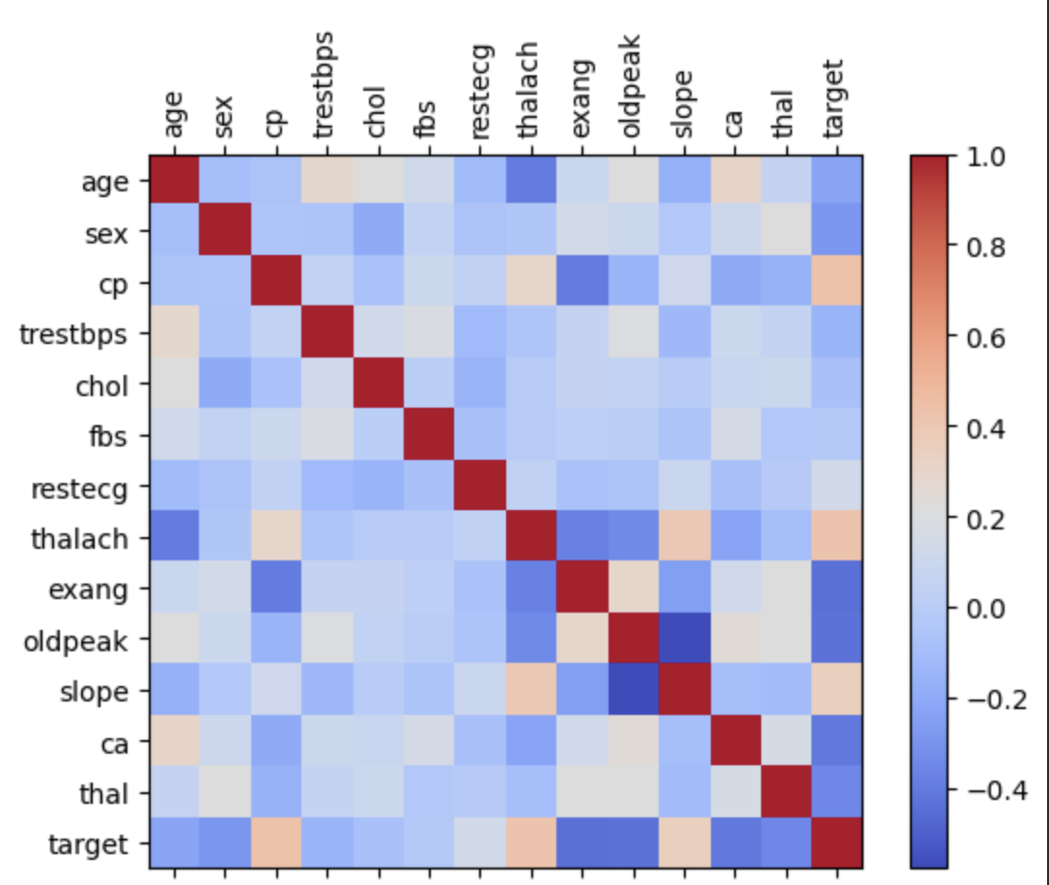
Feature Correlation Heatmap
Gives correlation coefficient values among all features
Shades of Red – stronger positive correlation
Shades of Blue – stronger negative correlation

Slide 6
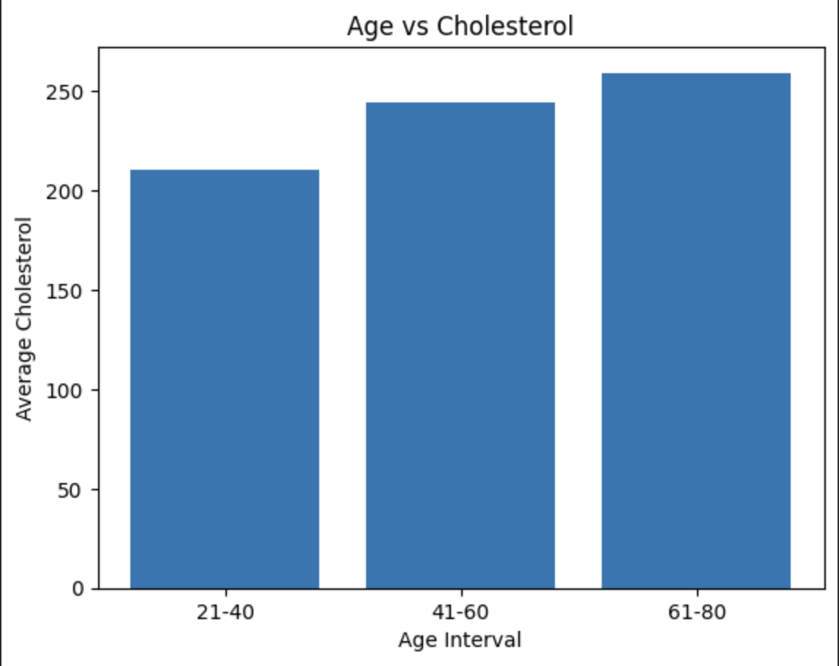
Average Cholesterol by Age
Data divided into Age Intervals
Older people having more average cholesterol levels than younger people

Slide 7
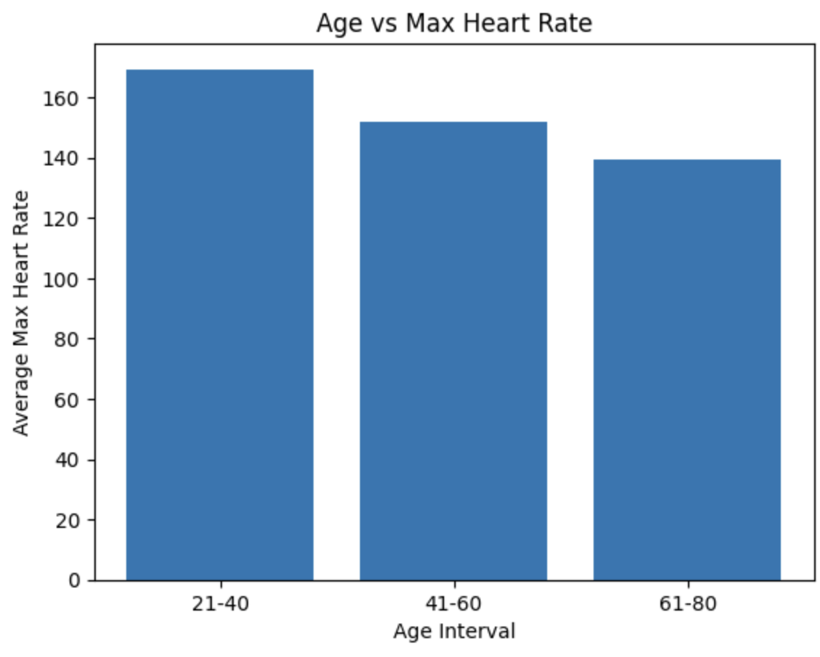
Average Max Heart Rate by Age
Plotting thalach -- maximum heart rate achieved during exercise
Increased Heart Rate during exercise means healthier heart
Older people have lower max heart rate during exercise than younger people

Slide 8
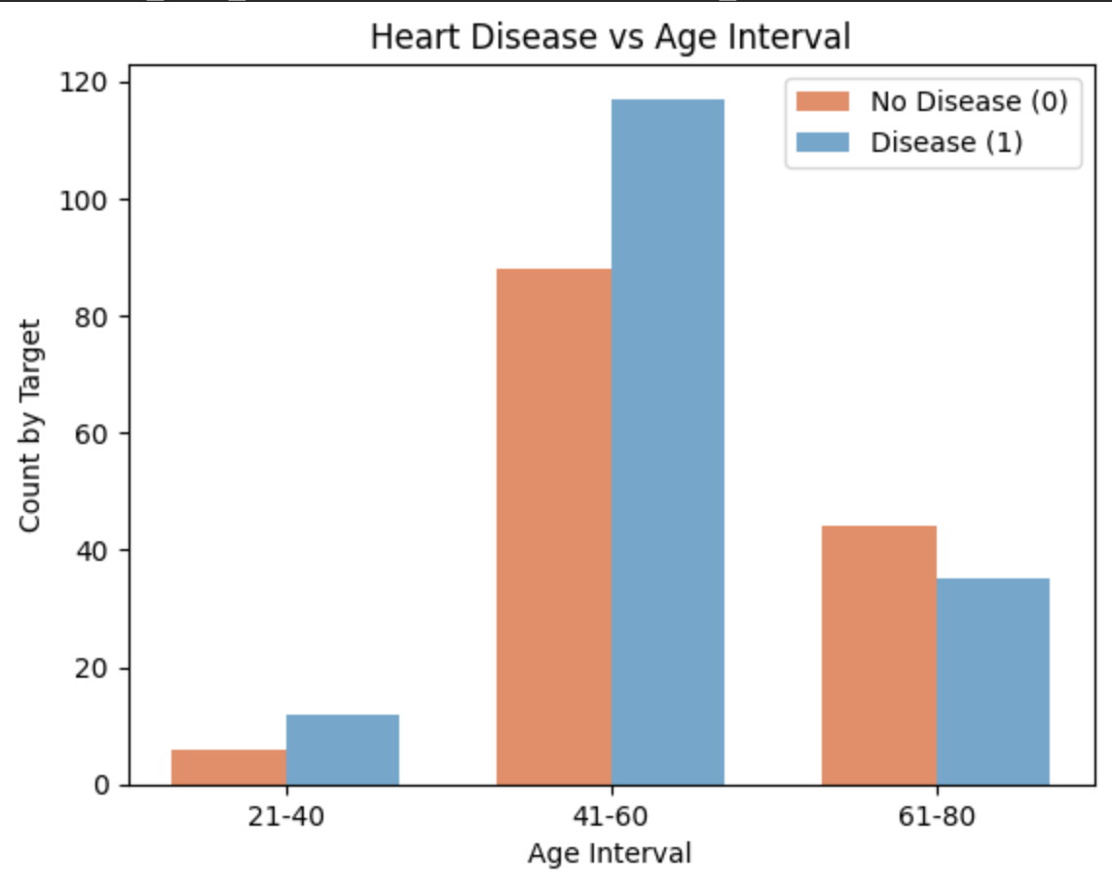
Heart Disease by Age
Checking the number of people in each interval with and without heart disease
Among all people in the middle age group, majority have a heart disease
The unusual trend could be due to effect of other features

Slide 9
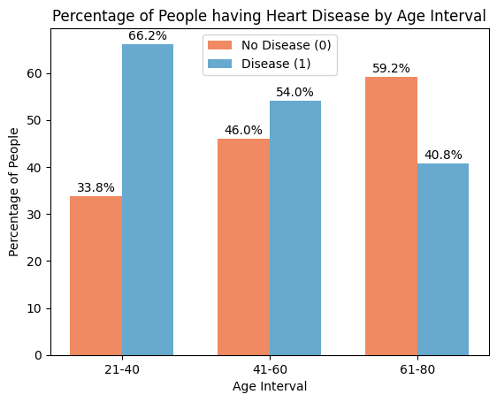
Heart Disease % by Age
Percentage instead of absolute count gives a more clear picture
Around 66% young people, 54% middle-aged people and 41% old-aged people in our dataset have heart disease

Slide 10
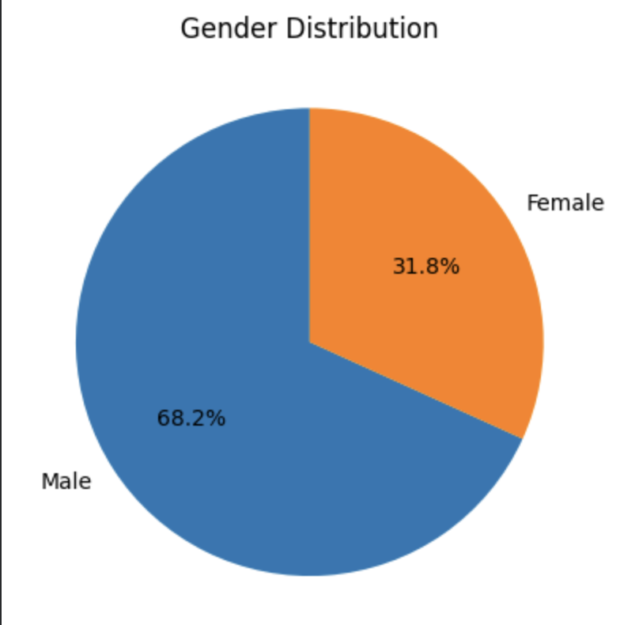
Gender Distribution
Pie chart shows distribution of our dataset with respect to gender.
We have around 68% male and 32% female in our dataset

Slide 11
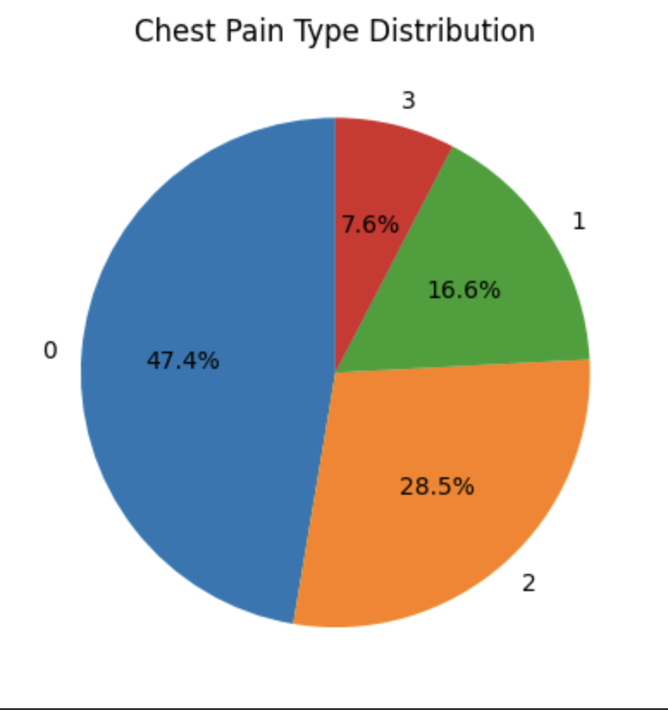
Chest Pain Type Distribution
Pie chart shows distribution of dataset with respect to chest pain type
Majority people in our dataset (47.4%) have reported a chest pain of type 0, followed by 28.5% reporting chest pain of type 2

Slide 12
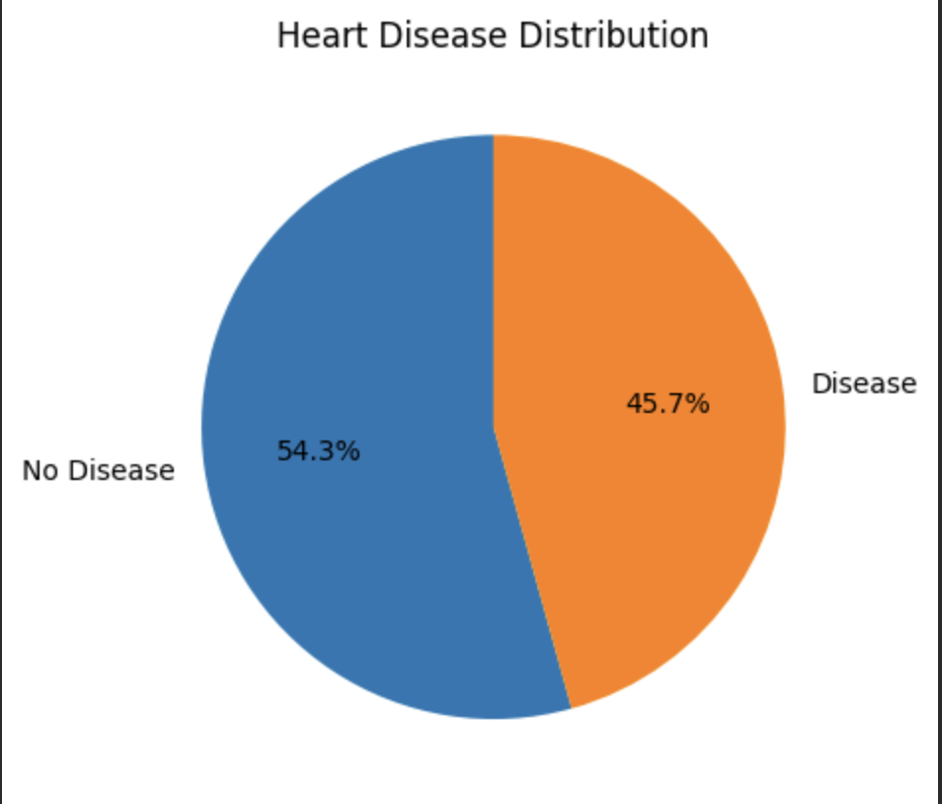
Heart Disease Distribution
Pie chart shows distribution of our dataset with respect to Heart Disease
Around 46% people in our dataset have heart disease

Slide 13
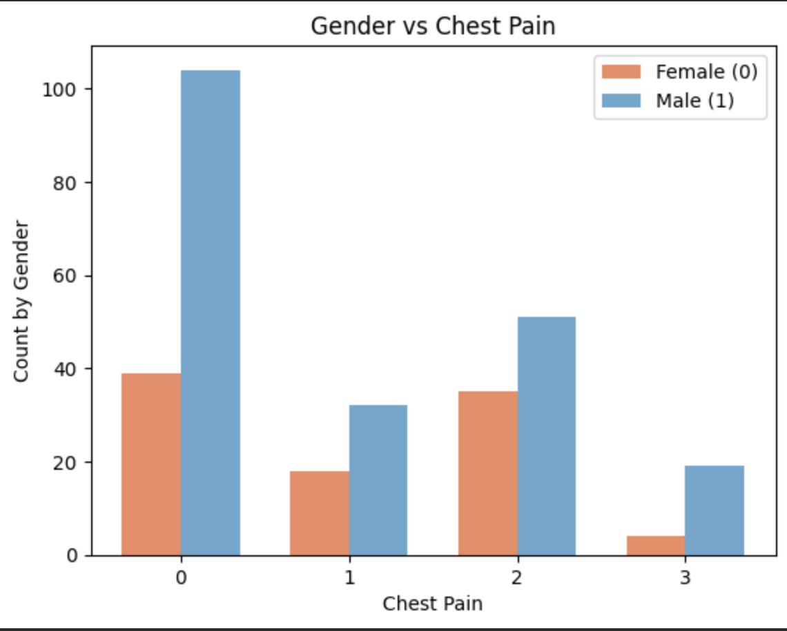
Gender vs Chest Pain
For each type of chest pain, we visualize the number of male vs female in each group

Slide 14
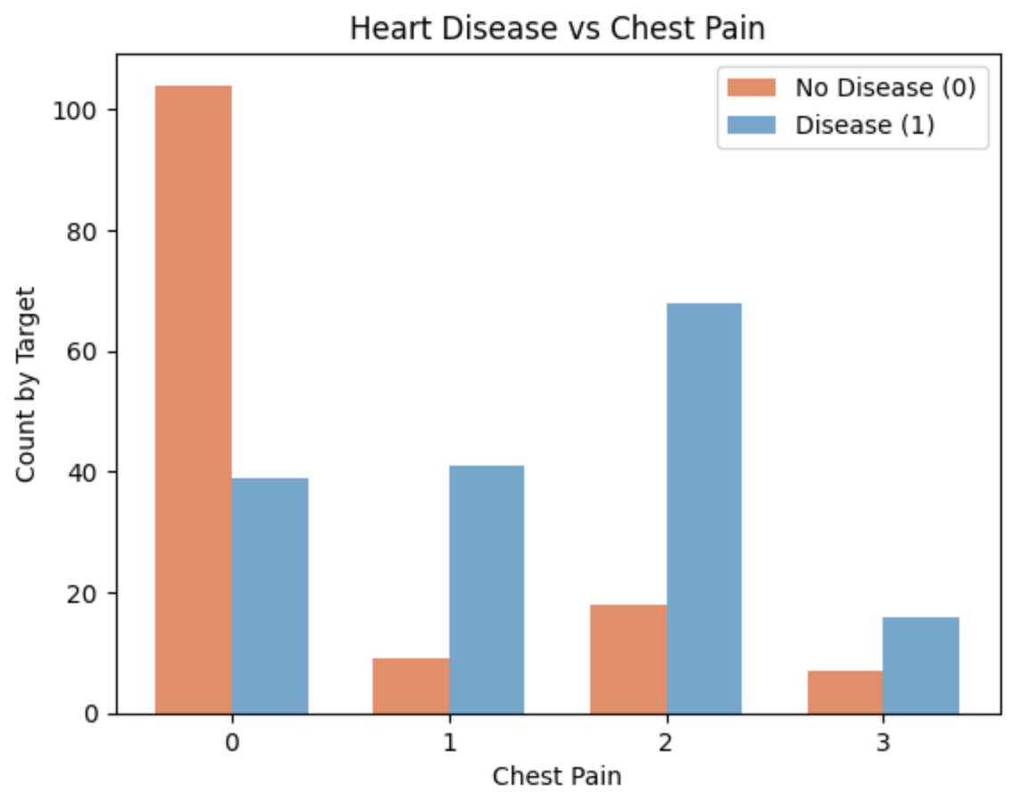
Heart Disease vs Chest Pain
For each type of chest pain, we visualize the number people who have Heart Disease
Majority of the people having chest pain type 0 do not have the heart disease
For all other chest pain types, we have majority people suffering from the heart disease

Slide 15

Modelling
Create a model to predict presence or absence of heart disease
Train model with 70% of data
Test model on remaining 30%

Slide 16
Linear Regression
Feature Selection: using hypothesis testing (SelectKBest package) –
Checks correlation between all features and target
Tests null hypothesis : no relation between Xi and y
Calculates test statistic
Concludes based on p-value
Top 7 most significant features selected
Split the data into training and test sets using 70-30 rule
Used a Linear Regression Model to predict the target variable from input feature values

Slide 17
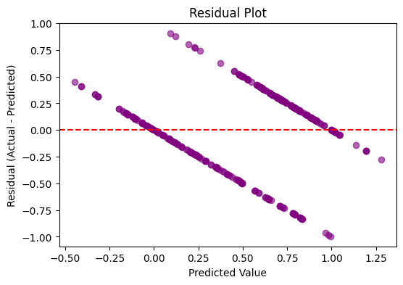
Model Accuracy
R² is approximately 0.42197 => only 42% of the variation of y is explained by our model
Model predicts majority values with significant error.
Model performance is poor – mainly because data labels are binary (Logistic model will be a better fit)

Slide 18
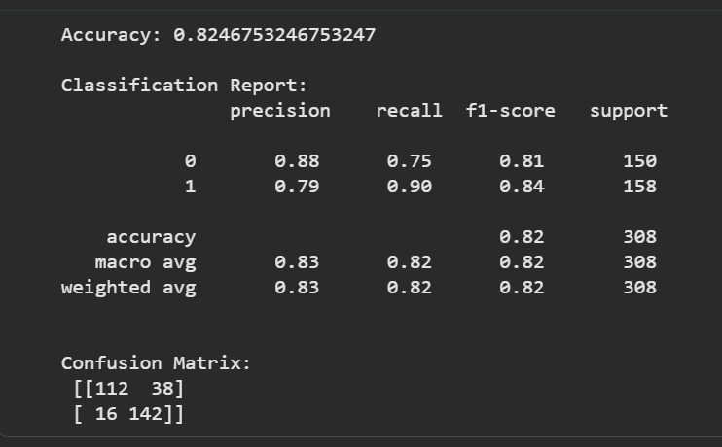
Logistic Regression
Used same 70-30 split, but with all features to fit a Logistic Regression Model
Model accuracy is 82.5% -- overall performance not too bad
Low Type I Error -- Total number of False Positives (predicting as ‘disease’ when that is false) is 38.

Slide 19
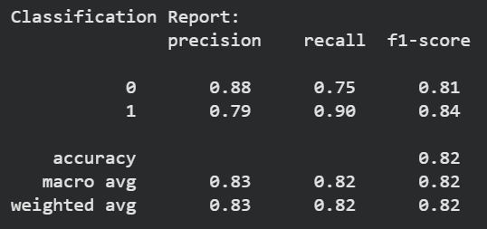
Model Performance
The Classification Report shows that:
For Class 0 (No Heart Disease)
Precision: 0.88 means out of all predicted “no disease”, 88% were really no disease.
Recall: 0.75 means out of all actual “no disease” cases, the model correctly found 75%.
It missed 25% of them → that matches the 38 false positives in confusion matrix.
F1-score: 0.81 gives a balance of precision & recall (the higher the better)
For Class 1 (With Heart Disease)
Precision: 0.79 means when the model predicts “disease”, it is correct 79% of the time.
It still has 21% false alarms.
Recall: 0.90 means the model catches 90% of patients who actually have heart disease.
Only 16 are False Negatives out of 158.
F1-score: 0.84

Slide 20
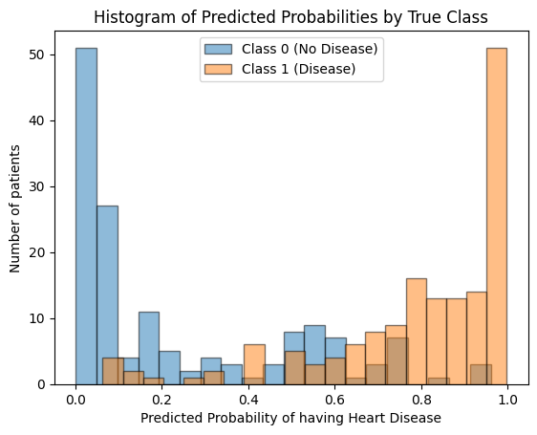
Visualizing Model Performance
Most of the actual patients with no disease (blue bars) have been predicted to have low probability of having the disease.
Most of the actual patients with the disease (orange bars) have been predicted to have high probability of having the disease.

Slide 21
GUI for Heart Disease Prediction
Built using Streamlit to make the model interactive and easy to use.
Logistic Regression chosen because it fits binary prediction and gives 0–1 probability outputs.
Linear Regression gave poor performance (R² = 0.42) and invalid predictions, so it was not used.
GUI allows input of clinical features: chest pain type, angina, max heart rate, ST depression, slope, vessels, thal.
Model displays: Prediction (1/0), probability score, and a risk message.
Example 1: High-risk inputs → Heart Disease, probability 0.8463.
Example 2: Low-risk inputs → No Heart Disease, probability 0.4678.

Slide 22
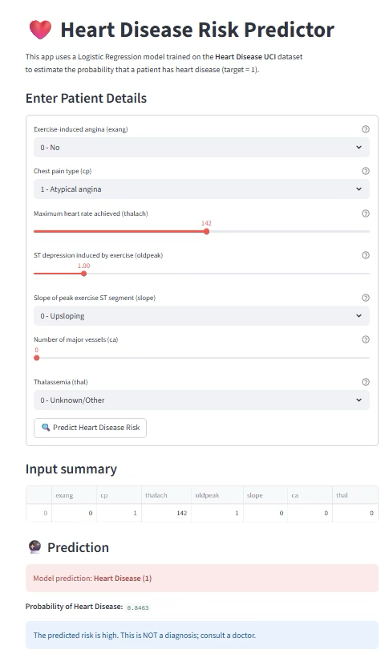
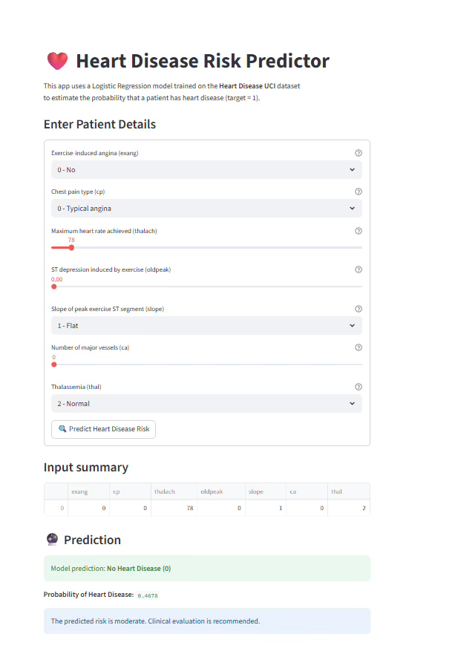
GUI Examples
Heart Disease (1)
No Heart Disease (0)

Slide 23
Future Work
Explore Advanced Models: Implement and evaluate robust classification algorithms like Random Forest (RF), XGBoost, SVM, and Neural Networks (MLP).
Comparative Analysis: Focus on finding a model that offers a better balance of predictive performance (higher recall for the "disease" class) and computational efficiency.
Cross-Dataset Validation: Rigorously test the current Logistic Regression model on multiple, distinct heart disease datasets to demonstrate model robustness and generalizability.
Integrate Statistical Visualizations: Enhance the GUI by incorporating bar charts and histograms to contextualize the individual's predicted risk.
Intuitive Risk Assessment: Enable users to see their predicted risk level compared to the overall population distribution for more intuitive and interpretable results.

Slide 24
Conclusion
Pre-processing - accuracy and reliability
Visualizations - uncover key trends and insights
Linear Regression model - performed poorly due to the binary target
Logistic Regression model - meaningful predictive performance
Interactive, user-friendly GUI or dashboard for non-technical users
Delivered an end-to-end solution - from data cleaning and analysis to modeling and deployment

Slide 25
References
[1] Ashika & Grace, 2025. Ensemble-based RST-ML approach.
[2] Ganie & Pramanik, 2025. Explainable AI for heart disease.
[3] Kumar & Dhanka, 2025. Hybrid framework combining deep learning.
[4] Mao & Jimma, 2025. ML algorithms for diagnosis.
[5] Rehman & Naseem, 2025. Advanced ML for CHD.
[6] Tseng & Sun, 2025. Comparative ML study.
[7] Ahmad & Polat, 2023. Cleveland dataset study.
[8] Bhuiyan et al., 2024. CBR for heart disease.
[9] Islam et al., 2024. ML-based cardiovascular identification.

